Slide 1
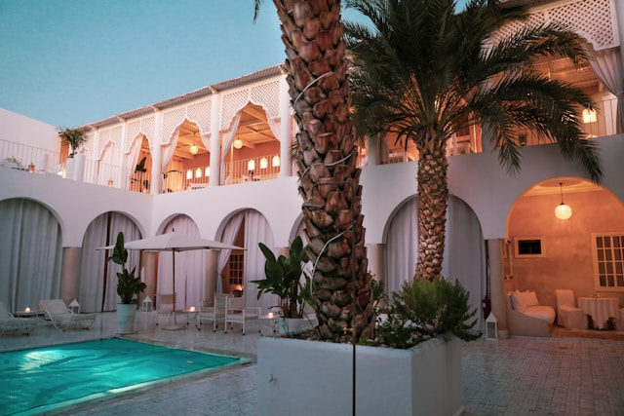










Call us to find out more
{d.contact}
{d.property}
{d.town}
Price starts at {d.price:formatC}
{d.description}
ABOUT THE PROPERTY
Energy-efficient
Low GHG
 | Property |  | Living area |  | Land surface
 | {d.property} |  | {d.livArea} m² |  | {d.landArea} m²
 | Rooms |  | Bedrooms |  | Bathrooms
 | {d.rooms} |  | {d.bedroom} |  | {d.bathroom}
 | Heating |  | Parking |  | Misc.
 | {d.heat} |  | {d.park} |  | {d.other}
≤ 50 A
{d.DPE}
≤ 5 A
{d.GHG}
51 à 90 B
kWh/m².an
6 à 10 B
kg CO₂/m².an
91 à 150 C
11 à 20 C
151 à 230 D
21 à 35 D
231 à 330 E
36 à 55 E
331 à 450 F
56 à 80 F
> 450 G
>80 G
Energy-intensive
High GHG

